Slide 1

Crowdfunding

Slide 2
Our Team (Group No. 4)
1. Jotsana Tukaram Desai
2. Darshan P Hidakal
3. P Reshma
4. Atharv Nilkanth Budhe
5. Sumit Shalikram Wanare
6. Shubha. V

Slide 3
Crowdfunding
Crowdfunding is the practice of funding a project, business, or initiative by collecting small amounts of money from a large number of people, typically through an online platform. This approach allows individuals, organizations, or businesses to raise funds from a diverse group of people, often in exchange for rewards, equity, or interest.
Crowdfunding benefits:
Access to funds: Raises capital from a large number of people, reducing reliance on traditional funding sources.
Community engagement: Builds a community around the project or business, fostering support and loyalty.
Validation: Demonstrates demand and interest in the project or product.
Marketing: Generates buzz and publicity through social sharing and online platforms.

Slide 4
Kickstarter
Kickstarter is a crowdfunding platform that allows creators to raise funds for their projects or ideas by collecting small amounts of money from a large number of people, typically in exchange for rewards or equity.
Here's how it works:
Project creation: Someone with an idea creates a project on Kickstarter, setting a funding goal and a deadline.
Rewards: The project creator offers rewards to backers in exchange for their pledges, such as early access, exclusive content, or physical products.
Pledging: People support the project by pledging money, choosing from the available rewards.
All-or-nothing funding: If the project reaches its funding goal within the deadline, the creator receives the funds. If not, the project is cancelled, and backers are refunded.
Project execution: The creator uses the funds to complete the project, then delivers rewards to backers.

Slide 5
Problem Statement
Identify predictors of project success and failure
Understand backer behaviour and motivations
Uncover trends and patterns in crowdfunding data
Provide actionable recommendations for project creators and backers

Slide 6
Key Performance Indicators (KPIs)
Accuracy: Percentage of accurate insights and recommendations.
Timeliness: Time taken to deliver insights and reports.
Data Quality: Percentage of complete, valid, and consistent data.
Stakeholder Satisfaction: Satisfaction ratings from stakeholders.
Insight Adoption: Percentage of insights implemented by stakeholders.
Return on Investment (ROI): Revenue generated compared to costs.
Data Coverage: Percentage of relevant data sources being analysed.
Analysis Depth: Complexity and thoroughness of analysis.
Communication Effectiveness: Clarity and impact of presentations and reports.
Process Efficiency: Streamlining of workflows and reduction of manual effort.
Data Storytelling: Ability to effectively communicate insights through narratives.
Technical Skills: Proficiency in tools, technologies, and methodologies.

Slide 7
Methodology
Data Collection and Preprocessing
Data Sources: Kickstarter crowdfunding website
Data Cleaning: cleaning the data adjusting the data types extracting Profit.
Visualization Tools
Tools: Excel, Power BI, Tableau for visualizing data and findings.
Data Management: Use SQL for efficient data querying and management throughout the analysis process

Slide 8
Recommendations
Based on the analysis, here are some potential recommendations for crowdfunding project analysis: For Project Creators:
Set realistic funding goals: Ensure goals are achievable based on project type, audience, and market conditions.
Choose the right platform: Select a platform that aligns with your project's niche and target audience.
Craft a compelling pitch: Develop a clear, engaging, and well-structured pitch that showcases your project's value.
Leverage social media and marketing: Utilize social media, email marketing, and other channels to promote your project and engage with potential backers.
Offer attractive rewards: Provide rewards that align with backer interests and are competitive with similar projects.

Slide 9
Conclusion
This comprehensive analysis of crowdfunding data has provided actionable insights into the factors influencing project success, backer behaviour, and trends in crowdfunding. The findings suggest that:
Project characteristics, such as goal amount, deadline, and category, significantly impact success rates.
Backer behaviour, including pledge amounts and frequency, varies across projects and platforms.
Trends in crowdfunding data, such as platform market share and project volume, indicate a growing and evolving industry.
By applying these insights, project creators can optimize their campaigns, backers can make informed investment decisions, and platforms can refine their services to better support users.

Slide 10
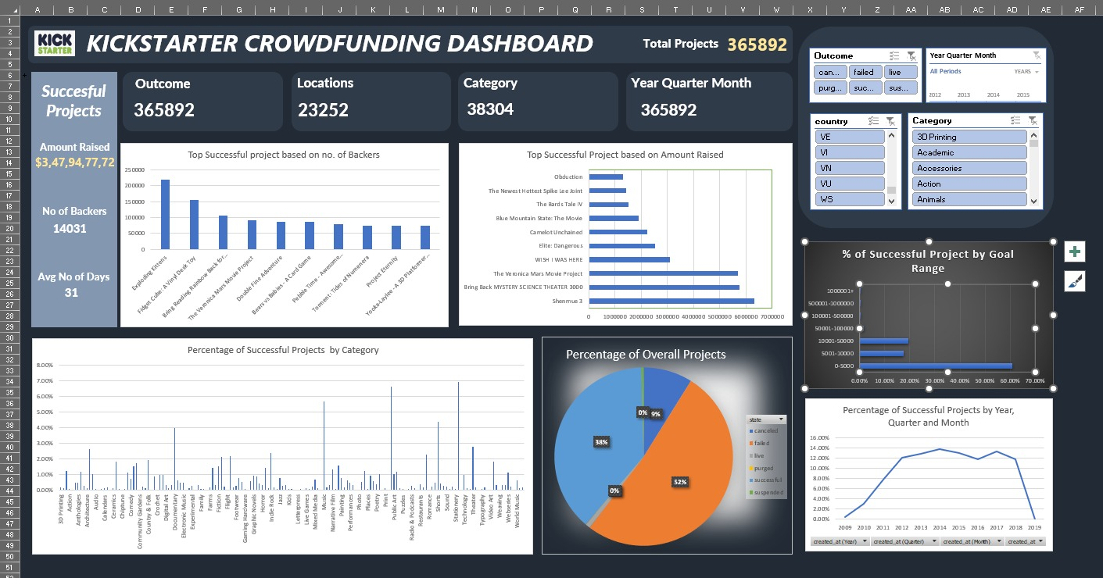
Excel Dashboard

Slide 11
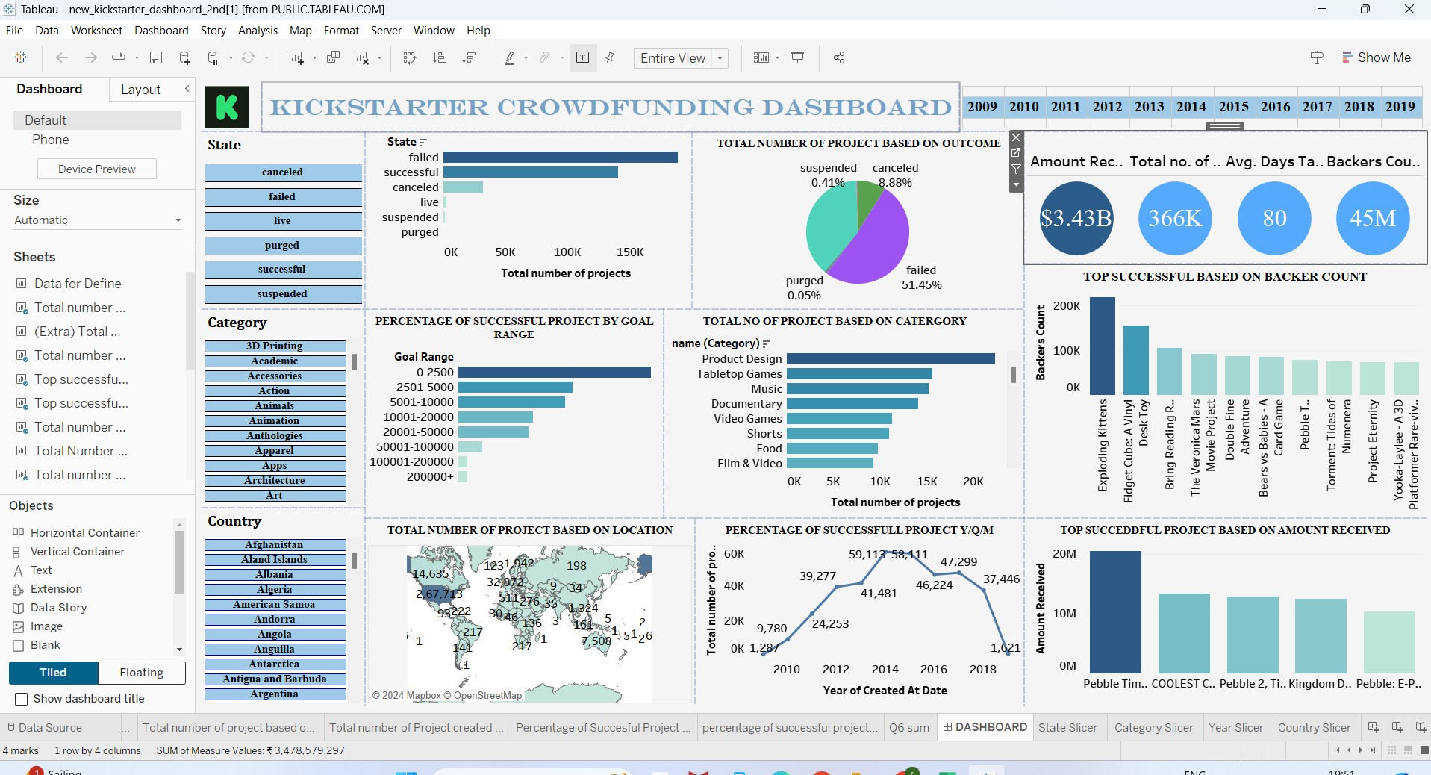
Tableau Dashboard

Slide 12
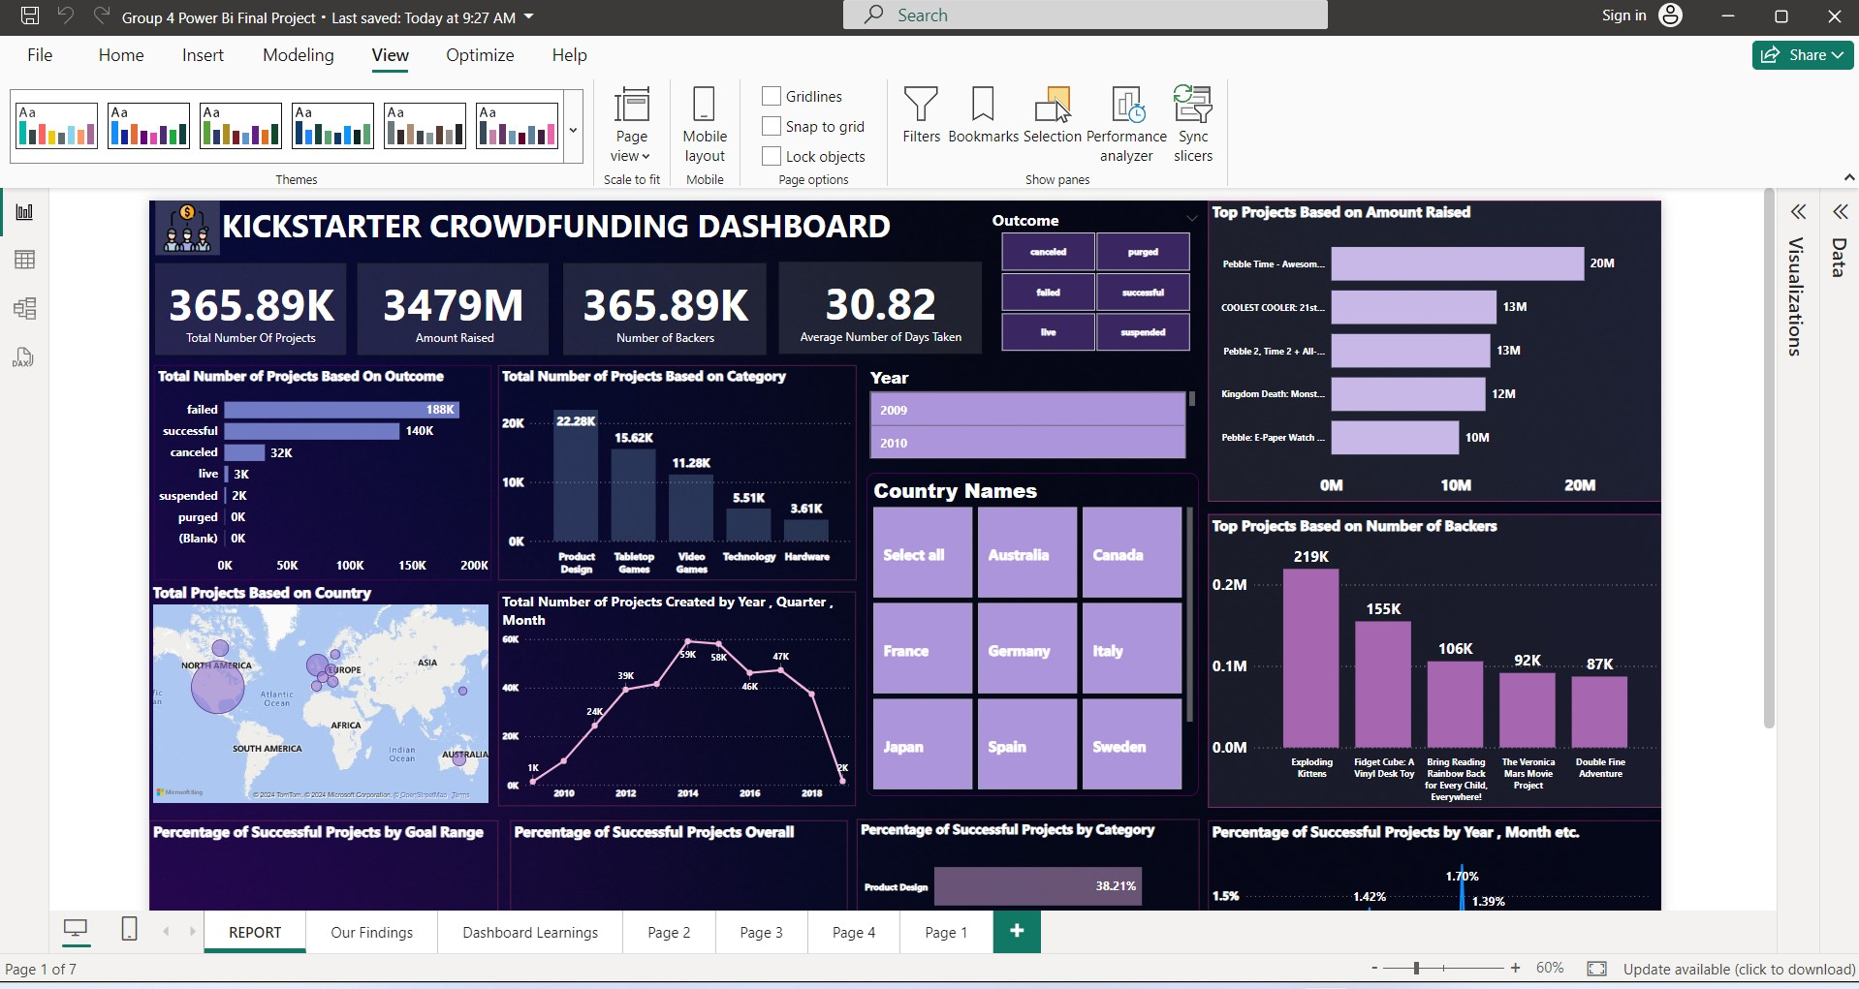
Power Bi Dashboard

Slide 13
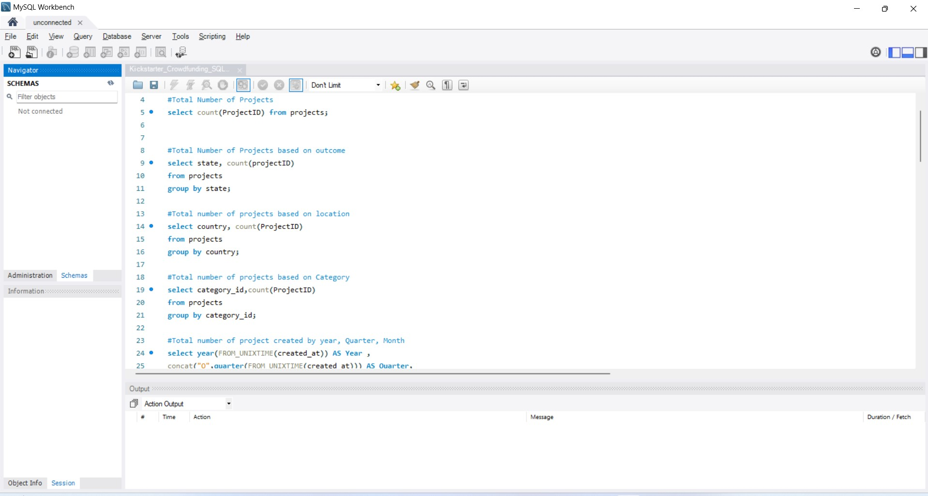
MySQL Queries

Slide 14
Thank you….

